Slide 1
Artificial Intelligence (AI) refers to the simulation of human intelligence in machines that are designed to think, learn, and make decisions. AI encompasses a wide range of technologies, including rule-based systems, expert systems, and machine learning algorithms.
Key Features of AI:
Automation of tasks that require human intelligence.
Ability to learn from data and improve over time.
Applications across various domains, including healthcare, finance, and robotics.

Slide 2
AI vs ML vs DL
Artificial Intelligence (AI):
The broadest concept, referring to machines that can perform cognitive functions similar to humans.
Encompasses ML, DL, and rule-based systems.
Examples: Virtual assistants, autonomous vehicles, and recommendation systems.
Machine Learning (ML):
A subset of AI that enables machines to learn patterns from data without explicit programming.
Uses statistical models and algorithms like decision trees, regression, and clustering.
Examples: Fraud detection, predictive analytics, and spam filters.
Deep Learning (DL):
A specialized subset of ML that relies on deep neural networks.
Requires large datasets and computational power.
Examples: Image recognition, natural language processing, and speech recognition.
Applications of AI
AI has transformed multiple industries by enabling automation and improving decision-making. Some major applications include:
Healthcare: Disease diagnosis, personalized medicine, robotic surgeries.
Finance: Fraud detection, algorithmic trading, risk assessment.
Retail: Recommendation systems, demand forecasting, customer sentiment analysis.
Autonomous Systems: Self-driving cars, drones, robotics.
Natural Language Processing: Chatbots, virtual assistants, language translation.

Slide 3
Conventional AI vs Generative AI (GenAI)
Conventional AI:
Focuses on classification, prediction, and rule-based decision-making.
Uses structured datasets for training.
Examples: Spam filters, customer service chatbots, recommendation engines.
Generative AI (GenAI):
A type of AI that creates new content, such as text, images, and music.
Uses models like GANs (Generative Adversarial Networks) and transformers (e.g., GPT, DALL-E).
Examples: AI-generated art, chat-based content generation, and text-to-image synthesis.
Future of AI
The future of AI is expected to bring significant advancements and challenges:
AI-Augmented Creativity: More sophisticated generative models for content creation.
Explainable AI (XAI): Enhancing transparency and trust in AI decision-making.
Ethical AI Development: Addressing biases, privacy concerns, and responsible AI use.
AI in Edge Computing: Deployment of AI models on edge devices for real-time processing.
Superintelligence and AGI: Theoretical advancements toward artificial general intelligence (AGI) with human-like reasoning capabilities.
AI continues to evolve, driving innovation and transforming industries worldwide.

Slide 4
Introduction to Deep Learning
Deep Learning (DL) is a subset of Machine Learning that utilizes artificial neural networks with multiple layers to learn complex patterns in data. It enables high-level feature extraction from raw data and is the foundation for many modern AI applications.
Key Aspects of Deep Learning:
Multi-layered neural networks (deep networks) that extract hierarchical features.
Requires large datasets and significant computational power (e.g., GPUs, TPUs).
Performs exceptionally well in tasks like image recognition, natural language processing, and speech synthesis.

Slide 5
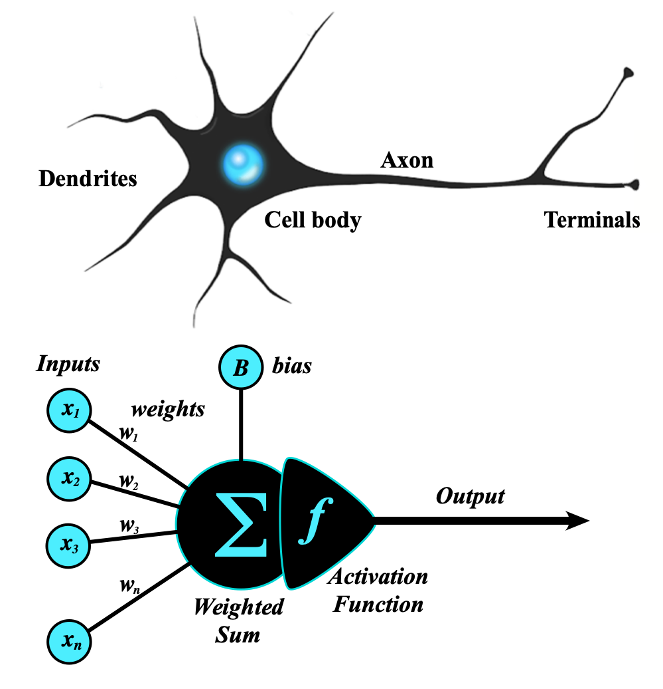
Perceptron Model
The perceptron is the simplest form of an artificial neural network and serves as the building block of more advanced models.
Components of a Perceptron:
Inputs: Feature values from the dataset.
Weights: Assigned to each input to signify importance.
Summation Function: Computes the weighted sum of inputs.
Activation Function: Applies a threshold to determine output.
Types of Perceptron Models:
Single-layer perceptron: Can only solve linearly separable problems.
Multi-layer perceptron (MLP): Can solve non-linear problems using multiple layers.
https://s.mriquestions.com/what-is-a-neural-network.html

Slide 6
Introduction to TensorFlow and Keras
TensorFlow and Keras are two of the most widely used deep learning frameworks.
TensorFlow:
Developed by Google Brain.
Provides low-level and high-level APIs for building deep learning models.
Supports large-scale machine learning and deployment.
Keras:
High-level API built on TensorFlow.
Simplifies model building and experimentation.
Allows quick prototyping with minimal code.

Slide 7
TensorFlow code
What is TensorFlow?
TensorFlow is an end-to-end open-source machine learning platform with a focus on deep neural networks. Deep learning is a subtype of machine learning that analyses massive amounts of unstructured data. Since it works with structured data, deep learning is different from normal machine learning.
importtensorflowastfprint("TensorFlow version:",tf.__version__)
How to install TensorFlow ?
pip install tensorflow
If you have a good graphics card in your computer,
pip install tensorflow-gpu
Check Installation
import tensorflow as tf
print(tf.__version__)
Some TensorFlow Fundamentals

Slide 8
Some TensorFlow Fundamentals
a tensor is a multi-dimensional array of data that can be used to represent data and perform mathematical operations. Tensors are a generalization of vectors and matrices,
What are tensors used for?
Training neural networks: Tensors store the weights and parameters of neural networks, and are used in the algorithms that train them
Representing data: Tensors can represent data such as images, movies, sounds, and relationships between words
Clustering: Tensors can be used in clustering algorithms such as k-means clustering
Support vector machines: Tensors can represent data in support vector machines
Why are tensors important?
Tensors are efficient with memory, making them ideal for parallel computing environments
Tensors are versatile and efficient at handling data

Slide 9
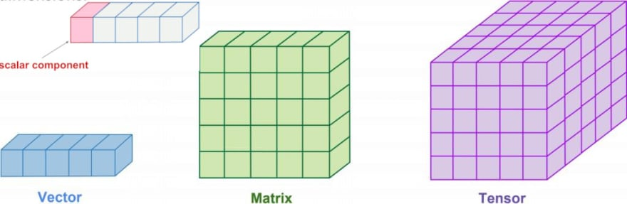
What are tensors built from?
The values in a tensor contain identical data types with a specified shape. Dimensionality is represented by the shape. A vector, for example, is a one-dimensional tensor, a matrix is a two-dimensional tensor, and a scalar is a zero-dimensional tensor.
import tensorflow as tf
x=tf.constant([[1.,2.,3.],[4.,5.,6.]])
print(x)
print(x.shape)
print(x.dtype)

Slide 10
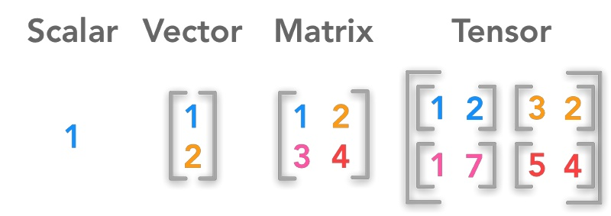
Shape
In the TensorFlow Python library, the shape corresponds to the dimensionality of the tensor. In simple terms, the number of elements in each dimension defines a tensor’s shape.

Slide 12
Introduction to Types of Neural Networks
Deep learning includes various types of neural networks optimized for specific tasks:
Feedforward Neural Networks (FNN):
Basic architecture where information moves in one direction.
Used in classification and regression tasks.
Convolutional Neural Networks (CNN):
Specialized for image processing tasks.
Uses convolutional layers to detect spatial features.
Recurrent Neural Networks (RNN):
Designed for sequential data like time series and speech.
Uses loops and memory to retain information from previous inputs.
Long Short-Term Memory (LSTM):
A type of RNN that solves the vanishing gradient problem.
Used in text generation, language modeling, and speech recognition.
Generative Adversarial Networks (GANs):
Consist of a generator and a discriminator that compete to generate realistic data.
Used in AI-generated art, deepfake videos, and data augmentation.
https://colab.research.google.com/drive/1z_nL3RcvR1x4uIR88VWEj8Zdr7mYEcQK#scrollTo=keCSdzvOrRmx
Implement the FNN

